Slide 1



MULTIVARIATE ANALYSIS
MULTIPLE REGRESSION
Data and Business Analytics
S T A T I S T I C S & P R O B A B I L I T Y F O R D A T A A N A L Y S I S A N D M A N A G E M E N T
Manoel Gadi, Ph.D.
2025

Slide 2
Categorical Variable
df[var].value_counts(normalize=True)
Chi-Square Test
Exploratory Data Analysis
Unbiased variable with Normal Distribution
Any of this can prove normality: Shapiro, KS, Jarque-Bera and Histogram
Use mean (parametric test)
T-test
ANOVA test if 3+ groups
Numerical
Variable
df[var].describe()
Capped discrete, very skewed or with no Normal Distribution
Use median (non-parametric test)
Mann–Whitney test
Kruskal Wallis if 3+ groups and non-parametric

Slide 3
Look the data
Not enough columns or rows
(univariate and bivariate analysis only)
Yes, enough columns or rows
(multivariate analysis, too much work to do it by hand)
Multivariate Methods
They will help us
No target variable (no label data) no column informing what needs to be predicted
Yes, target variable (labelled data) there is a column informing what needs to be predicted
Unsupervised
Supervised
#colums * 20 > # rows
Or Multicollinearity /Correlation/Causality
Target continuous
Target Binary / Categorical
#colums * 20 < # rows
EDA
PCA
Cluster
Regression
Classification
(-) Worse models/inference
(+) Better models/inference

Slide 4



Dependence Tests ….
Dependence Techniques
Multiple regression
Multiple Discriminant analysis
Logistic regression
Analyze the relationship between a single dependent (criterion) variable and several independent (predictor) variables

Slide 5
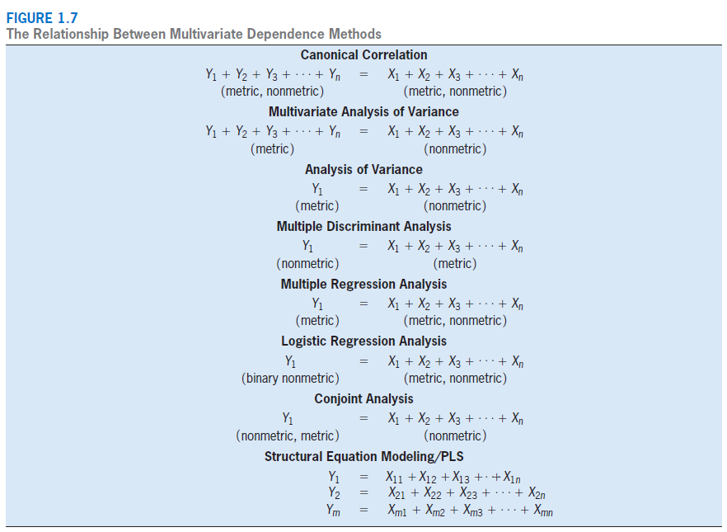

Slide 6
Multivariate Regression: The Variate
A variate value (Y’) is calculated for each respondent.
Y’ = b₀ + b₁X₁ + b₂X₂ + . . . + b_{n}X_{n} + e
The Y’ value is a linear combination of the entire set of variables that best achieves the statistical objective.
Y = Dependent Variable = # of credit cards
b₀ = intercept (constant) = constant number of credit
X₃
cards independent of family size and income.
b₁ = change in # of credit cards associated with a unit change in family size (regression coefficient).
b = change in # of credit cards associated with a unit change in income (regression coefficient).
X₁ = family size X₂ = income
e = prediction error (residual)
Y’
X₁
2
X₂

Slide 7
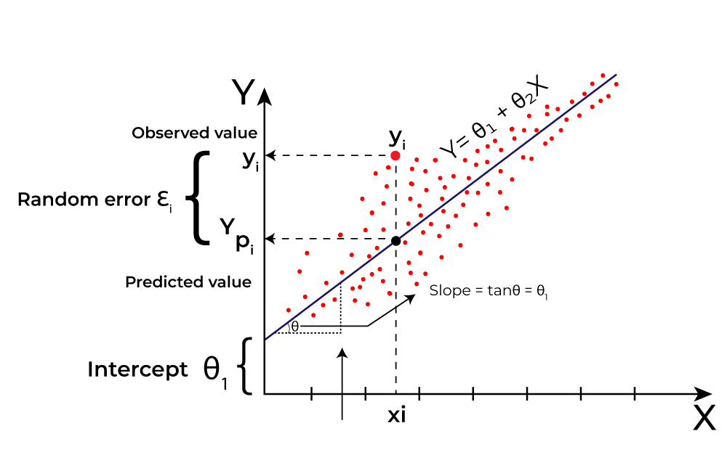

Slide 8

Ejercicio
Definición de los datos para la construcción de modelos para el análisis multivariado.
Objetivo de aprendizaje: esta actividad tiene como objetivo probar su capacidad para definir cada paso dentro de un modelo multivariado e identificar los principales problemas dentro de cada paso.
Se le pide que diga cuántos coches en movimiento hay en una calle de 2 sentidos de 1 km de largo en este momento. No tienes imágenes satelitales, lo único que tienes es una moto para recorrer la calle y contar los carros. No se puede dar un número exacto de autos porque todos los autos se están moviendo, por lo que su trabajo es dar su mejor estimación. Defina cómo recolectaría los datos (usando la motocicleta, puede viajar por la calle 0 veces, en 1 sentido o en ambos sentidos o muchas veces) y luego defina cada etapa del esquema del modelo a continuación y analice una o dos de sus principales limitaciones (para cada etapa).
Fill: https://github.com/manoelgadi/Peppermoney/blob/main/Template_Activity%203.2-MODEL%20BUILDING_V2.pptx

Slide 9
ACTIVITY 3.2 – A SIX-STAGE APPROACH TO MULTIVARIABLE MODEL BUILDING
Stage 1. Objectives
Stage 2. Analysis Plan / Design
Stage 3. Assumptions
LIMITATIONS
LIMITATIONS
LIMITATIONS
Stage 6. Validation
Stage 5. Model Interpretation: statistical vs practical significance
(For activity 3.2 leave this part blank)
Stage 4. Model Building: Parameter's estimation
LIMITATIONS
LIMITATIONS
(For activity 3.2 leave this part blank)
LIMITATIONS
9

Slide 10
ACTIVITY 3.2 – A SIX-STAGE APPROACH TO MULTIVARIABLE MODEL BUILDING
Stage 1. Objectives
Stage 2. Analysis Plan / Design
Stand at the end of 1st way, count the number of cars
passing by for X minutes (Depending on speed limit of the street if 30km/h = 30km/60min = 1km/2min), multiply number by 2 and store the number in a list, in a second list store the time (month-day-hour-minute- dayofweek), in a third list to store the weather condition (sunny, rainy, snowy…), in a 4th list the number of lanes in that street, repeat the process for the 2nd way until our lists has 30 inputs(15 in each way). Repeat this process for 10 days in a different 1km 2 way street each day. (end sample = 300)
Stage 3. Assumptions
Sum of number of cars moving in a 1km 2 way street live
Cars are not allowed overtaking,
Random distribution of cars, Cars are all going at the speed limit,
The two ways of a street
have the same number of cars
LIMITATIONS
Measurement is an estimation that will lack accuracy
LIMITATIONS
Special events/holydays, Population specific characteristics
LIMITATIONS
Assumptions are not always ensured in real life scenarios
Stage 6. Validation
Stage 5. Model Interpretation: statistical vs practical significance
Stage 4. Model Building: Parameter's estimation
The model is a Regression: y = b0 + b1*x1
+ b2*x2 + …. + b7*x7
b0 will be the average of the first list
x1, x2, x3, x4, x5 will be minute, hour, day, month, day of week
x6 will be the number of lanes in the street
x7 will be a categorical variable representing the weather condition
y is the prediction for number of moving cars
Cross-validation by splitting the data on the basis of the different streets (10 streets total)
(For activity 3.2 leave this part blank)
LIMITATIONS
Some of the inputs recorded might be false due to human error
LIMITATIONS
(For activity 3.2 leave this part blank)
LIMITATIONS
Some of the inputs recorded might be false due to human error
1

Slide 11
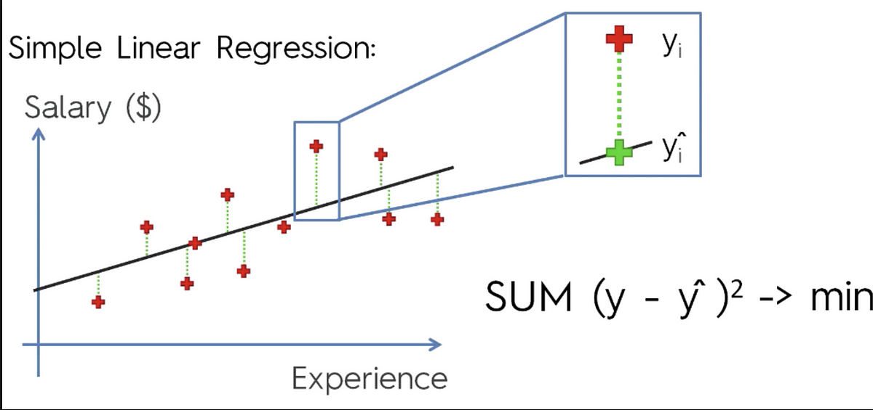
Stage 4

Slide 12
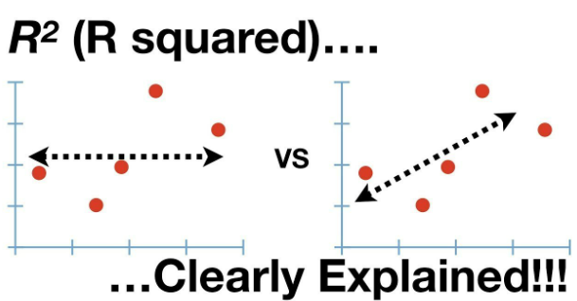
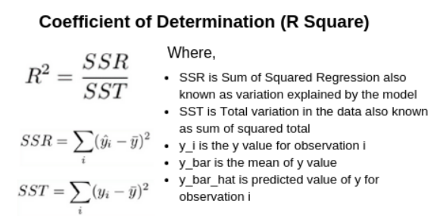

Slide 13
ACTIVITY 2 – SIX-STAGE APPROACH TO MULTIVARIABLE MODEL BUILDING FOR LINEAR REGRESSION ANALYSIS
Stage 1. Objectives
Stage 2. Analysis Plan / Design
Stage 3. Assumptions
LIMITATIONS
LIMITATIONS
LIMITATIONS
Stage 6. Validation
Stage 5. Model Interpretation: statistical vs practical significance
.
Stage 4. Model Building: Parameter's estimation
LIMITATIONS
LIMITATIONS
.
LIMITATIONS
13

Slide 14
SIX-STAGE APPROACH TO MULTIVARIABLE MODEL BUILDING FOR LINEAR REGRESSION ANALYSIS
Stage 1. Objectives
Multiple Regression Analysis: target exists and is only one.
Y₁ = X₁ + X₂ + X₃ + ... + Xₙ
(metric) = (metric, nonmetric)
Stage 2. Analysis Plan / Design
Must scale each x in X (standard scale or min-max scale)
No missing values (apply remedies)
Outliers (Remove or Flag)
Dummy variable all Categorical Nominal or Ordinal variables
Sample size: minimum 20 with 5 rows to column. Recommend: 50 with 20 rows to column.
Stage 3. Assumptions
Linearity (between x ~ y)
Normality (each x)
Homoscedasticity (y ~ y_pred)
No Multicollinearity (X)
Independence (rows of X) - no autocorrelation
LIMITATIONS
Cannot be used for multiple targets, unsupervised learning or categorical target
LIMITATIONS
Should not be used if data does meet minimum standards or transformation and remedies cannot be applied.
LIMITATIONS
Remedies should be applied if assumptions not met
Remedies to multicollinearity: Lasso, Ridge or Bayesian / Regression on Principal Components
Stage 6. Validation
Sum of Squared Errors
Mean Squared Errors
R squared (R²)
Adjusted R squared (R²)
No drop higher than 10% I
n performance between train and test or cross-validation samples
Stage 5. Model Interpretation: statistical vs practical significance
Interpret coefficients
p-value < 5% (t-test – H0: coef = 0) - > Drop Feature
R-squared ( < 50% weak / > 90% overfitting?)
Stage 4. Model Building: Parameter's estimation
Goodness of fit (F-statistic)
Feature Selection (Confirmatory / Sequential / Combinatorial / Optimization)
LIMITATIONS
Population Drift
Relationship Drift
Slow Speed
LIMITATIONS
Not enough data, tests wrongly fail.
Too much data, tests invalid, wrongly always significant .
LIMITATIONS
Over-fitting: The model might leads to poor performance on new, unseen data.
Extrapolation for unknow ranges

Slide 15
Look the data
Not enough columns or rows
(univariate and bivariate analysis only)
Yes, enough columns or rows
(multivariate analysis, too much work to do it by hand)
Multivariate Methods
They will help us
No target variable (no label data) no column informing what needs to be predicted
Yes, target variable (labelled data) there is a column informing what needs to be predicted
Unsupervised
Supervised
#colums * 20 > # rows
Or Multicollinearity /Correlation/Causality
Target continuous
Target Binary / Categorical
#colums * 20 < # rows
EDA
PCA
Cluster
Regression
Classification
(-) Worse models/inference
(+) Better models/inference

Slide 16
Categorical Variable
df[var].value_counts(normalize=True)
Chi-Square Test
Exploratory Data Analysis
Unbiased variable with Normal Distribution
Any of this can prove normality: Shapiro, KS, Jarque-Bera and Histogram
Use mean (parametric test)
T-test
ANOVA test if 3+ groups
Numerical
Variable
df[var].describe()
Capped discrete, very skewed or with no Normal Distribution
Use median (non-parametric test)
Mann–Whitney test
Kruskal Wallis if 3+ groups and non-parametric

Slide 17



Multivariate Regression Analysis: Procedure
1.
Objectives
2.
Design
5.
Interpretation & Validation
Multiple regression
3.
Assumptions
4.
Model
5

Slide 18
Setting up the Objectives of Multiple Regression Analysis
Objectives | Design | Assumptions | Model | Interpretation | Validation
In selecting suitable applications of multiple regression, the researcher must consider three primary issues:
The appropriateness of the research problem;
Specification of a statistical relationship;
Selection of the dependent and independent variables:
Strong Theory;
Measurement error;
Specification error.

Slide 19
Research Problems Appropriate for Multiple Regression
Objectives | Design | Assumptions | Model | Interpretation | Validation
Prediction: of dependent variable with a set of independent variables with two objectives:
Maximize the overall predictive power of the independent variables as represented in the variate; interpretation of the regression coefficients is relatively unimportant.
Compare two or more sets of independent variables to ascertain the predictive power of each variate. e.g. confirmatory approach to modeling; which focuses on the relative predictive power among models.
Explanation: of dependent variable as a function of independent variables
Relative importance of each independent variable;
Nature of the relationship between the independent variables and the dependent variable;
Relationships among independent variables in their prediction of the dependent measure.

Slide 20
Specifying a Statistical Relationship
Objectives | Design | Assumptions | Model | Interpretation | Validation
Multiple regression is appropriate when the researcher is interested in a statistical, not functional relationship.
Functional relationship: no error is expected in the prediction → exact value
Total cost = Variable cost + Fixed cost
If the variable cost is $2 per unit, the fixed cost is $500, and we produce 100 units, we assume the total cost is $700. Any deviation from $700 is caused by our inability to measure cost because the relationship between costs is fixed.
Statistical relationship: some random component is always present in the relationship being examined → average value

Slide 21
Selection of Dependent and Independent Variables
Objectives | Design | Assumptions | Model | Interpretation | Validation
Strong theory: researcher should always perform the fundamental decision of variable selection based on conceptual grounds, even when the objective is solely for prediction.
Measurement error: degree to which the variable is an accurate and consistent measure of the concept being studied. It can be addressed through:
Summated scales: using multiple variables to reduce the reliance on any single variable as the sole representative of a concept.
Structural equation modeling: directly accommodates measurement error in estimating the effects of the independent variables in any specified dependence relationship.
Specification error: concerns the inclusion of irrelevant variables or the omission of relevant variables from the set of independent variables.
Inclusion of irrelevant variables: does not affect bias but reduces model parsimony and mask or replace the effects of more useful variables especially in sequential model estimation.
Exclusion of relevant variables: create bias and reduce the overall predictive accuracy of the model.

Slide 22
Objectives of Multiple Regression Analysis: Rules of Thumb
Objectives | Design | Assumptions | Model | Interpretation | Validation
Only structural equation modeling (SEM) can directly accommodate measurement error, but using summated scales can mitigate it when using multiple regression.
When in doubt, include potentially irrelevant variables (as they can only confuse interpretation) rather than possibly omitting a relevant variable (which can bias all regression estimates).

Slide 23
Design of Multiple Regression Analysis
Objectives | Design | Assumptions | Model | Interpretation | Validation
Simple regression can be effective with a sample size of 20, but maintaining power at
.80 in multiple regression requires a minimum sample of 50 and preferably 100 observations for most research situations.
The minimum ratio of observations to variables is 5 to 1, but the preferred ratio is 15 or 20 to 1, and this should increase when stepwise estimation is used (50:1).
Maximizing the degrees of freedom improves generalizability and addresses both model parsimony and sample size concerns.
Sample Size
Nonmetric variables can only be included in a regression analysis by creating dummy variables; which can only be interpreted in relation to their reference category.
Adding an additional polynomial term represents another inflection point in the curvilinear relationship. Quadratic & cubic polynomials are generally sufficient to represent most curvilinear relationships.
Assessing the significance of a polynomial or interaction term is accomplished by evaluating incremental R², not the significance of individual coefficients, due to high multicollinearity.
Creating Additional Variables

Slide 24
Design of Multiple Regression Analysis – Power Levels
Objectives | Design | Assumptions | Model | Interpretation | Validation
Table 1. Minimum R² that can be found statistically significant with a power of 0.80 for varying numbers of independent variables and simple sizes.
 | Significance level (α) =0.01 No. of Independent Variables |  |  |  | Significance level (α) =0.05 No. of Independent Variables
Sample Size | 2 | 5 | 10 | 20 | 2 | 5 | 10 | 20
20 | 45 | 56 | 71 | NA | 39 | 48 | 64 | NA
50 | 23 | 29 | 36 | 49 | 19 | 23 | 29 | 42
100 | 13 | 16 | 20 | 26 | 10 | 12 | 15 | 21
250 | 5 | 7 | 8 | 11 | 4 | 5 | 6 | 8
500 | 3 | 3 | 4 | 6 | 3 | 4 | 5 | 9
1,000 | 1 | 2 | 2 | 3 | 1 | 1 | 2 | 2
Note: Values represent % of variance explained.
e.g. if the researcher employs 5 independent variables, specifies a 0.05 significance level and is satisfied with detecting R² 80% of the time it occurs, a sample of 50 respondents will detect R² values of 23 percent and greater.

Slide 25
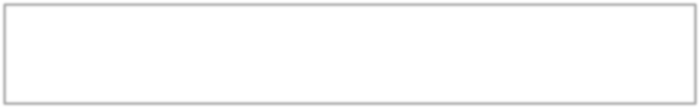
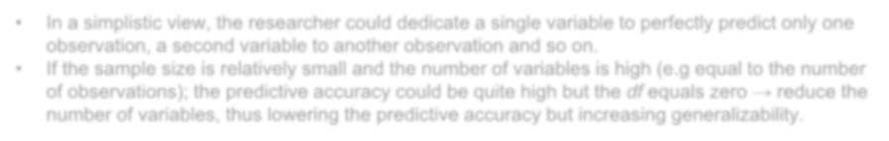
Design of Multiple Regression Analysis: Generalizability
Objectives | Design | Assumptions | Model | Interpretation | Validation
When the ratio of observations to variables falls below 5:1 → overfitting → results
too specific to the sample → lack of generalizability.
To understand the concept of Overfitting, we need to address the concept of
degrees of freedom:
Degrees of freedom (df) = Sample size – Number of estimated parameters For multivariate regression:
df = N – (Number of independent parameters + 1 (intercept))
The larger the degrees of freedom, the more generalizable the results:
Reduce the number of independent variables.
Increase the sample size.
In a simplistic view, the researcher could dedicate a single variable to perfectly predict only one observation, a second variable to another observation and so on.
If the sample size is relatively small and the number of variables is high (e.g equal to the number of observations); the predictive accuracy could be quite high but the df equals zero → reduce the number of variables, thus lowering the predictive accuracy but increasing generalizability.

Slide 26
Multiple Regression Analysis: Assumptions
Objectives | Design | Assumptions | Model | Interpretation | Validation
Linearity of the phenomenon measured.
Constant variance of the error terms.
Independence of the error terms.
Normality of the error term distribution.
After regression model estimation
Assessing Statistical Assumptions
Testing assumptions must be done not only for each dependent and independent variable, but for the variate as well.
Graphical analyses (i.e., partial regression plots, residual plots and normal probability plots) are the most widely used methods of assessing assumptions for the variate.
Remedies for problems found in the variate must be accomplished by modifying one or more independent variables.

Slide 27
Multiple Regression Assumptions: Residuals
Objectives | Design | Assumptions | Model | Interpretation | Validation
Principal measure of the prediction error of the variate: Difference between the observed and predicted value of the dependent variable.
To make residuals directly comparable → Standardization e.g. Studentized residual: most common; values correspond to t values.
Plotting the residuals versus the independent or predicted variables is a basic method of identifying assumption violations for the overall relationship.
Most common residual plot involves the residuals (r_{i}) versus predicted dependent values (Y_{i}). (Refer to Figure 5 of your textbook, pp 180)
Violations of each assumptions can be identified by specific patterns of the residuals.
Null plot (Figure 5a): plot of the residuals when all assumptions are met.

Slide 28
Multiple Regression Assumptions: Linearity
Objectives | Design | Assumptions | Model | Interpretation | Validation
Residual plots – enables you to determine if the errors are linear. Any consistent curvilinear pattern in the residuals indicates that the existence of nonlinear relationship not represented in the current model. (Figure 5b).
Corrective actions:
Transforming the data values (log, square roots, etc.) of one or more dependent variables → Partial regression plots: show the relationship o a single X_{i} to Y, controlling for the effects of all other independent variables.
Differ from overall residual plots in that the central line now slope up or down depending on the sign of regression coefficient associated with each independent variable.
Directly including the nonlinear relationship in the regression model through the creation of polynomial terms
Using special models such as nonlinear regression.

Slide 29
Multiple Regression Assumptions: Homogeneity of Variance
Objectives | Design | Assumptions | Model | Interpretation | Validation
The presence of unequal variances is one of the most common assumption violations.
Diagnosis:
Residual plots – triangle-shaped pattern in either direction is indicative on heteroscedasticity
Statistical test: Levene test for homogeneity of variances – highly recommended because it is less affected by departures from normality (another problem occurring in regression)
Remedies:
if violations are attributed to a single variable → weighted least squares regression method.
Variance-stabilizing transformations

Slide 30
Multiple Regression Assumptions: Normality of the Error Term
Objectives | Design | Assumptions | Model | Interpretation | Validation
Normal probability plot – enables you to determine if the errors are normally distributed. It compares the observed (sample) standardized residuals against the expected standardized residuals from a normal distribution.
Histogram of standardized residuals – enables you to determine if the errors are normally distributed.

Slide 31
Multiple Regression Assumptions: Multicollinearity
Objectives | Design | Assumptions | Model | Interpretation | Validation
The researcher’s task is to . . .
Assess the degree of multicollinearity,
Determine its impact on the results, and
Apply the necessary remedies if needed.
Examination of bivariate correlation matrix for the independent variables: first and simplest means of identifying collinearity (correlations of even 0.70 can be problematic)
To assess multicollinearity → measures the degree to which each
independent variable is explained by the set of other independent variables.
Tolerance and its inverse the Variance Inflation Factor

Slide 32
Multiple Regression Assumptions: Assessing Multicollinearity
Objectives | Design | Assumptions | Model | Interpretation | Validation
Tolerance
Tolerance – the amount of variance in an independent variable that is not explained by the other independent variables.
1 – R^{2*} (R^{2*} being the amount of independent variable that is explained by all other independent variables in the regression model).
Large tolerance values indicate small degree of multicollinearity.
The tolerance value must be smaller than .10 to indicate a problem of multicollinearity.
Variance Inflation Factor
Variance Inflation Factor (VIF) – measures how much the variance of the regression coefficients is inflated by multicollinearity problems.
If VIF equals 0, there is no correlation between the independent measures.
A VIF measure of 1 is an indication of some association between predictor variables, but generally not enough to cause problems. A maximum acceptable VIF value would be 10; anything higher would indicate a problem with multicollinearity.

Slide 33
Multiple Regression Assumptions: Remedies for Multicollinearity
Objectives | Design | Assumptions | Model | Interpretation | Validation
Omit one or more highly correlated independent variable and identify other independent variables to help predictions.
Use the model with the highly correlated independent variables for prediction only, while acknowledging the lowered level of overall predictive ability
Use a more sophisticated method of analysis such as Bayesian Regression
or Regression on Principle Components.

Slide 34
Multiple Regression Analysis: The Model
Objectives | Design | Assumptions | Model | Interpretation | Validation
Select a method for specifying the regression model to be estimated
Assess the statistical significance of the overall model in predicting the dependent variable, and
Determine whether any of the observations exert an undue influence on the results.

Slide 35
Multiple Regression Model: Estimation Technique
Objectives | Design | Assumptions | Model | Interpretation | Validation
Three possible approaches:
Confirmatory (Simultaneous): researcher specifies the exact set of independent variables to be included.
Trade-off between more independent variables and greater predictive accuracy versus model parsimony and concise explanation
Sequential Search Methods:
Stepwise (variables not removed once included in regression equation).
Forward Inclusion & Backward Elimination.
Hierarchical.
Combinatorial (All-Possible-Subsets)

Slide 36
Multiple Regression Model: Stepwise Search Methods
Objectives | Design | Assumptions | Model | Interpretation | Validation
Start with simple regression model with one independent variable (most highly correlated with Y).
Examine the partial correlation coefficients to determine the next X_{i} to add
Re-compute the regression equation using the two X_{i}. Then, examine the partial F values for the original variable in the model for statistical significance. If not→ eliminate the first X_{i}.
Continue this procedure by examining all independent variable not in the model to determine whether to make a statistically significant addition to current model, etc.
Caveats:
Multicollinearity: omission of variables that might be highly related to the dependent variable
Loss of researcher control
Increase in the overall error rate due to large number od statistical tests preformed.

Slide 37
Multiple Regression Model: Other Sequential Search Methods
Objectives | Design | Assumptions | Model | Interpretation | Validation
Forward Addition & Backward elimination
Trial-and-error processes
Forward addition is similar to stepwise procedure except that once a
variable is entered → cannot be removed
Backward elimination: starts with all variables in model and then delete independent variables that do not contribute significantly.

Slide 38
Multiple Regression Model: Estimation Technique
Objectives | Design | Assumptions | Model | Interpretation | Validation
Irrespective of the technique chosen; theory must be a guiding factor in evaluating the final regression model because:
Confirmatory Specification, the only method to allow direct testing of a pre- specified model, is also the most complex from the perspectives of specification error, model parsimony and achieving maximum predictive accuracy.
Sequential search (e.g., stepwise), while maximizing predictive accuracy, represents a completely “automated” approach to model estimation, leaving the researcher almost no control over the final model specification.
Combinatorial estimation, while considering all possible models, still removes control from the researcher in terms of final model specification even though the researcher can view the set of roughly equivalent models in terms of predictive accuracy.
No single method is “Best”; better to use a combination of approaches.

Slide 39
Multiple Regression Model: Statistical vs. Practical Significance
Objectives | Design | Assumptions | Model | Interpretation | Validation
F statistic → test if overall regression model is statistically significant.
If the F statistic is significant (p-value < 0.05) → unlikely your sample will produce a large R² when the population R² is actually zero.
Coefficient of Determination; R² → Evaluate the strength of the linear association between the dependent variable and the several independent variables (goodness-of-fit).
→ Strength of the overall relationship the amount of the dependent variable “explained” by the independent variables combined.
→ 0 to 1: A large R² indicates the straight line works well while a small R² indicates it does not work well.
Even though an R² is statistically significant, it does not mean it is practically significant.
For example, is the value of knowing you have explained 4 percent of the variation worth the cost of collecting and analyzing the data?

Slide 40
Multiple Regression Model Significance: Rules of Thumb
Objectives | Design | Assumptions | Model | Interpretation | Validation
Always ensure practical significance when using large sample sizes, as the model results and regression coefficients could be deemed irrelevant even when statistically significant due just to the statistical power arising from large sample sizes.
Use the adjusted R² as your measure of overall model predictive accuracy.
Statistical significance is required for a relationship to have validity, but statistical significance without theoretical support does not support validity.
While outliers may be easily identifiable, the other forms of influential observations requiring more specialized diagnostic methods can be equal to or even more impactful on the results.

Slide 41
Multiple Regression Model: Influential Observations
Objectives | Design | Assumptions | Model | Interpretation | Validation
Influential observations . . . include all observations that have a disproportionate effect on the regression results. There are three basic types based upon the nature of their impact on the regression results:
Outliers are observations that have large residual values and can be identified only with respect to a specific regression model.
Leverage points are observations that are distinct from the remaining observations based on their independent variable values.
Influential observations are the broadest category, including all observations that have a disproportionate effect on the regression results. Influential observations potentially include outliers and leverage points but may include other observations as well.

Slide 42
Multiple Regression Model: Corrective Actions for Influential Observations
Objectives | Design | Assumptions | Model | Interpretation | Validation
Influentials, outliers, and leverage points are based on one of four conditions, each of which has a specific course of corrective action:
An error in observations or data entry – remedy by correcting the data or deleting the case,
A valid but exceptional observation that is explainable by an extraordinary situation – remedy by deletion of the case unless variables reflecting the extraordinary situation are included in the regression equation,
An exceptional observation with no likely explanation – presents a special problem because there is no reason for deleting the case, but its inclusion cannot be justified either, suggesting analyses with and without the observations to make a complete assessment, and
An ordinary observation in its individual characteristics but exceptional in its combination of characteristics – indicates modifications to the conceptual basis of the regression model and should be retained.
Copyright © 2010 Pearson Education, Inc., publishing as Prentice-Hall.
Fall 2019
Multivariate Analysis
30

Slide 43
Multiple Regression Analysis: Result Interpretation
Objectives | Design | Assumptions | Model | Interpretation | Validation
Coefficient of Determination
Regression Coefficients (Unstandardized – bivariate)
Mostly for prediction purposes
Beta Coefficients (Standardized)
Guide to relative importance of individual independent variable only when collinearity is minimal
Interpreted only in the context of the other variables in the equation
Variables Entered
Multicollinearity ??

Slide 44
Multiple Regression Analysis: Result Interpretation
Objectives | Design | Assumptions | Model | Interpretation | Validation
Multicollinearity: May be considered “good” when it reveals a suppressor effect, but generally it is viewed as harmful since increases in multicollinearity:
Reduce the overall R² that can be achieved;
Confound estimation of the regression coefficients;
Negatively affect the statistical significance tests of coefficients.
Generally accepted levels of multicollinearity (tolerance values up to .10, corresponding to a VIF of 10) almost always indicate problems with multicollinearity, but these problems may be seen at much lower levels of collinearity or multicollinearity.

Slide 45
Multiple Regression Analysis: Result Interpretation
Objectives | Design | Assumptions | Model | Interpretation | Validation
Bivariate correlations of .70 or higher may result in problems, and even lower correlations may be problematic if they are higher than the correlations between the dependent and independent variables.
Values much lower than the suggested thresholds (VIF values of even 3 to 5) may result in interpretation or estimation problems, particularly when the relationships with the dependent variable are weaker.
A rule of thumb is that we need 15 observations for each predictor.

Slide 46
Multiple Regression Analysis: Validation
Objectives | Design | Assumptions | Model | Interpretation | Validation
Additional or Split Samples
Calculating the PRESS Statistic
Measure similar to R², used to assess the predictive accuracy of the estimated regression model
n – 1 regression models are estimated.
Procedure omits one observation in the estimation of the regression model and then predicts the omitted observation and so on and so forth.
The residuals of the observations are then summed to provide an overall measure of predictive fit.
Comparing Regression Models: Adjusted R²
Forecasting with the Model

Slide 47
References
Objectives | Design | Assumptions | Model | Interpretation | Validation
Joseph, F. Hair Jr, William C. Black, Barry J. Babin & Ralph E. Anderson. Multivariate Data Analysis. Pearson. 7th edition. Chapter 4.

